Slide 1
21CSC201J DATA STRUCTURES AND ALGORITHMS UNIT-3 Topic : Infix to Postfix Conversion

Slide 2
Infix to Postfix Conversion
Infix Notation
Infix Notation is the common arithmetic and logical formula notation.
In which operators are written infix-style between the operands they act on.
Example: A + B

Slide 3
Infix to Postfix Conversion
Postfix Notation
In Postfix Notation, the operators come after the operands.
For example, the infix expression A + B will be written as AB+ in its Postfix Notation.
Postfix Notation is also called as “Reverse Polish Notation”

Slide 4
Infix to Postfix Conversion
Conversion from Infix to Postfix Algorithm
Step 1
Scan the Infix expression from left to right for tokens (Operators, operands and Parenthesis) and perform the steps 2 to 5 for each token in the expression.
Step 2
If token is operand, Append it in postfix expression.
Step 3
If token is left parenthesis “(“, push it in stack.

Slide 5
Infix to Postfix Conversion
Conversion from Infix to Postfix Algorithm
Step 4
If the token is an operator,
Pop all the operators that are of higher or equal precedence than the incoming token and append them (in the same order) to the output expression.
After popping out all such operators, push the new token on the stack.

Slide 6
Infix to Postfix Conversion
Conversion from Infix to Postfix Algorithm
Step 5
If “)” parenthesis is found,
Pop all the operators from the stack and append them to the output string, till you encounter the opening parenthesis “(“.
Pop the left parenthesis but don’t append it to the output string (Postfix notation does not have brackets).

Slide 7
Infix to Postfix Conversion
Conversion from Infix to Postfix Algorithm
Step 6
When all tokens of infix expression have been scanned. Pop all the elements from the stack and append them to the output string.
The output string is the corresponding postfix notation.

Slide 8
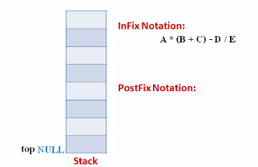
Infix to Postfix Conversion
Example
Let the infix expression be:
A * (B + C) – D / E
Stage 1:
The stack is empty and we have only the infix expression

Slide 9
Infix to Postfix Conversion
Example
Let the infix expression be:
A * (B + C) – D / E
Stage 1:
The stack is empty and we have only the infix expression

Slide 10
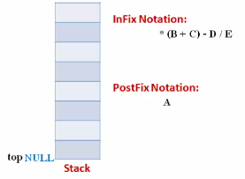
Infix to Postfix Conversion
Example
Stage 2:
The first token is operand A. Operands are appended to the output as it is.

Slide 11
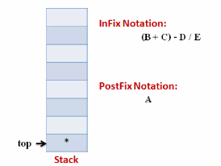
Infix to Postfix Conversion
Example
Stage 3:
Next token is * since stack is empty it is pushed into stack

Slide 12
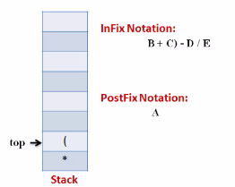
Infix to Postfix Conversion
Example
Stage 4:
Next token is ( the precedence of open parenthesis which is maximum.
But when another operator is to come on the top of ‘(‘ then its precedence is least.

Slide 13
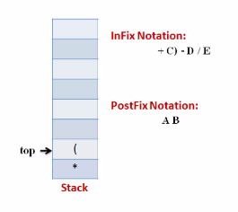
Infix to Postfix Conversion
Example
Stage 5:
Next token, B is an operand which will go to the output string

Slide 14
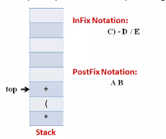
Infix to Postfix Conversion
Example
Stage 6:
Next token, + is an operator, we consider the precedence of top element in the stack. ‘(‘ . The outgoing precedence of open parenthesis is the least
So + gets pushed into the stack.

Slide 15
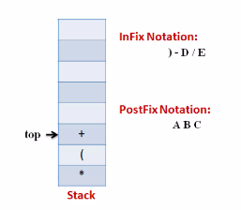
Infix to Postfix Conversion
Example
Stage 7:
Now token, C, is appended to the output

Slide 16
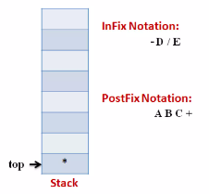
Infix to Postfix Conversion
Example
Stage 8:
Now token, ) , means that pop all the elements from stack and append them to the output till we read an opening parenthesis.

Slide 17
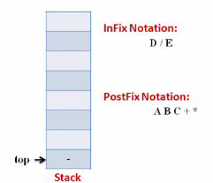
Infix to Postfix Conversion
Example
Stage 9:
Now token, - , is an operator. The precedence of operator on the top of stack ‘*’ is more than that of ‘-’. So we pop multiply and append it to output. Then push ‘– ‘ into stack.

Slide 18
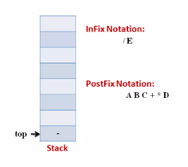
Infix to Postfix Conversion
Example
Stage 10:
Now token, D, is appended to the output

Slide 19
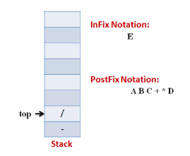
Infix to Postfix Conversion
Example
Stage 11:
Next we insert the ‘/’ operator into the stack because its precedence is more that the minus.

Slide 20
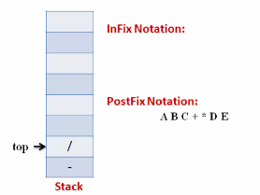
Infix to Postfix Conversion
Example
Stage 12:
Now token, E, is appended to the output

Slide 21
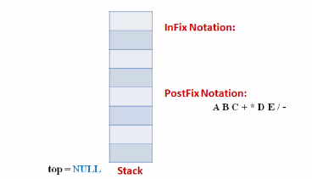
Infix to Postfix Conversion
Example
Stage 13:
The input expression is complete. So pop all the elements from stack and append to the output.

Slide 22
Thank You

